Slide 1
CBS3004
Artificial Intelligence

Slide 2
Definition
AI is a branch of computer science, aims on building machines and software with intelligence similar to humans so that they can perform similar thinking, reasoning, decision-making, problem solving and natural language processing like human.

Slide 3
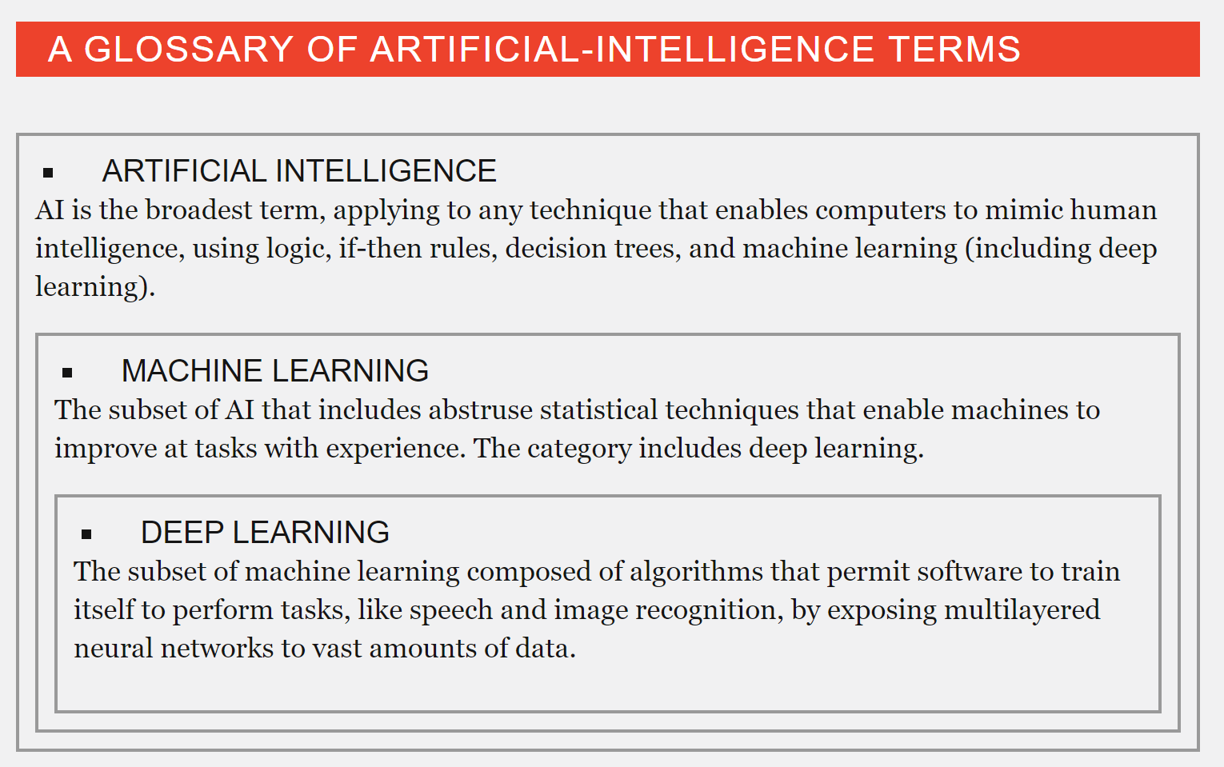

Slide 4
What is AI?
Artificial intelligence (AI) is technology and a branch of computer science that studies and develops intelligent machines and software.
“The study and design of intelligent agents”
An intelligent agent is a system that perceives its environment and takes actions that maximize its chances of success.
John McCarthy coined the term AI in 1956
Defines it as "the science and engineering of making intelligent machines".

Slide 5
Various Definitions of AI
AI is the automation of activities that we associate with human thinking, activities such as decision making, problem solving, learning… …
-Bellman, 1978
AI is concerned with designing intelligent computer systems which exhibit the characteristics we associate with intelligence in human behaviour
-Barr and Feignenbaum, 1981
AI is the exciting new effort to make computers think… … machines with minds, in the full and literal sense
- Haugeland, 1985

Slide 6
Various Definitions of AI Cont…
AI is the study of mental faculties through the use of computational models
-Charniak McDermott, 1985
AI is the art of creating machines that perform functions that require intelligence when performed by people
-Kurzwell, 1990
AI is the study of how to make computers do things at which, at the moment, people are better
-Rich and Knight, 1991

Slide 7
Various Definitions of AI Cont…
AI is the study of the combinations that make it possible to perceive, reason and act
-Winston, 1992
Computational intelligence is the study of the design of intelligent agents
-Poole et al., 1998
AI… is concerned with intelligent behavior in artifacts
-Nilsson, 1998

Slide 8
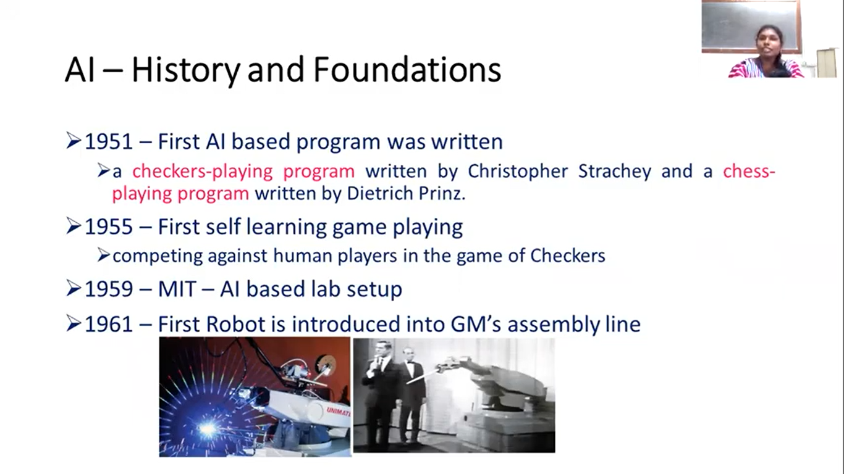
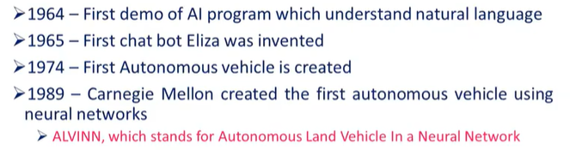

Slide 9
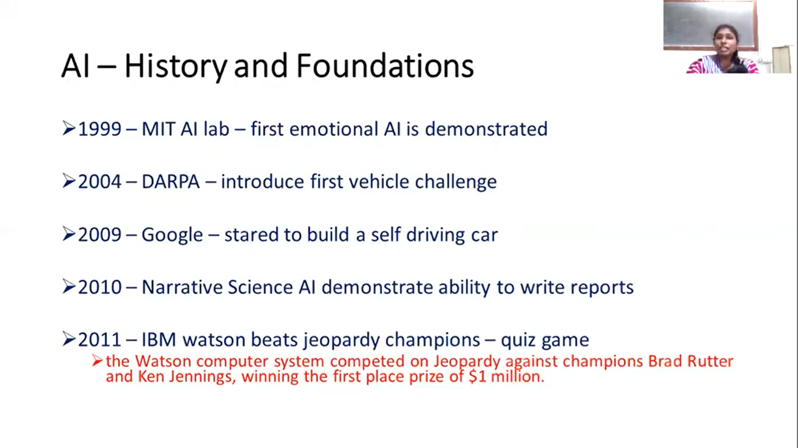
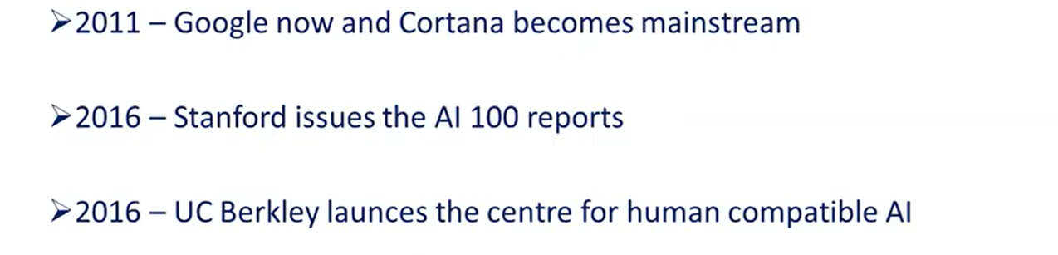

Slide 10
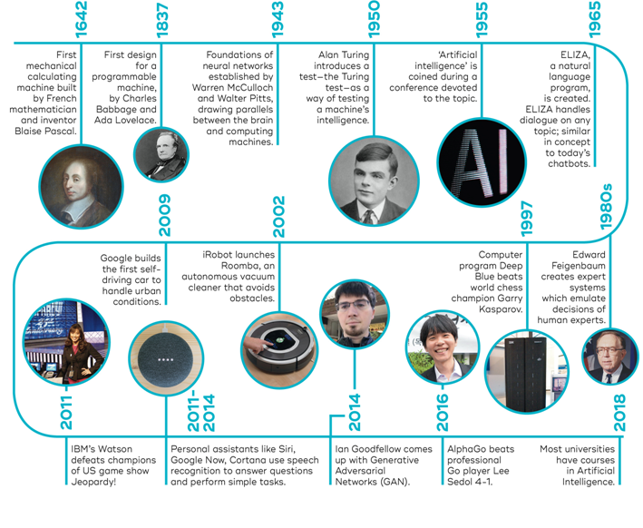
History of AI

Slide 11
The state of the art of AI
  Robotic vehicles
  Speech recognition
  Autonomous planning and scheduling
  Game playing
  Spam ﬁghting
  Robotics
  Machine Translation

Slide 12
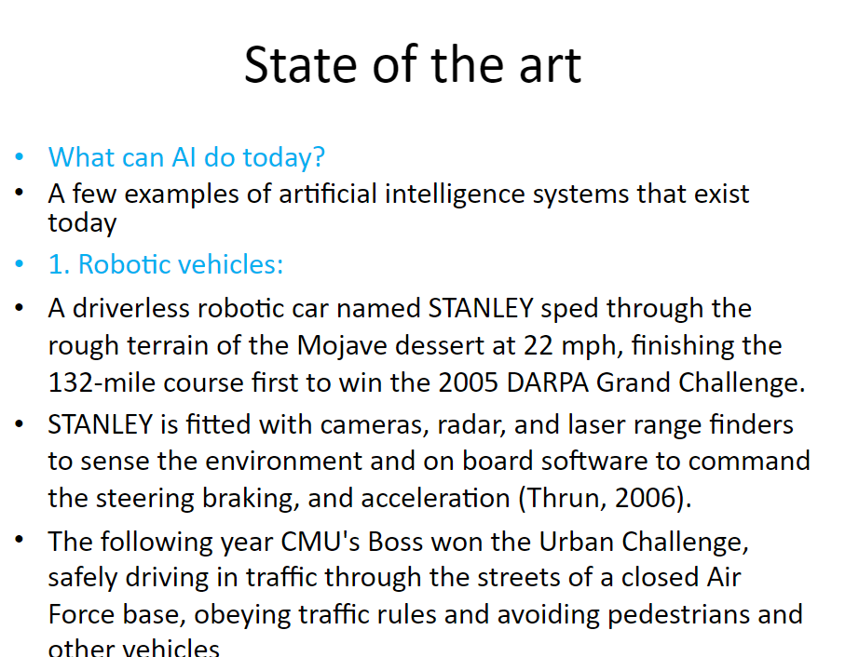

Slide 13
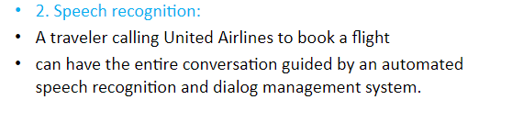
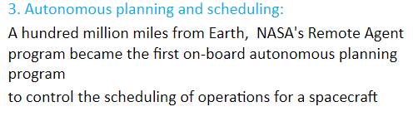
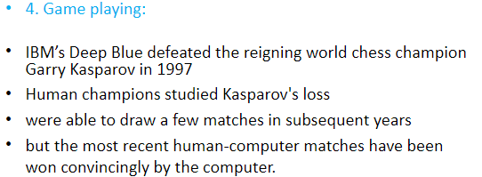

Slide 14
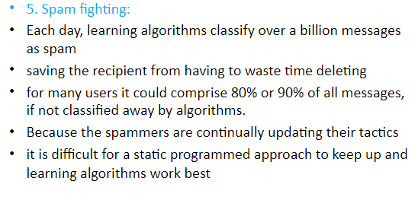
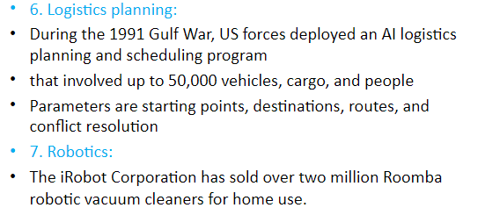

Slide 15
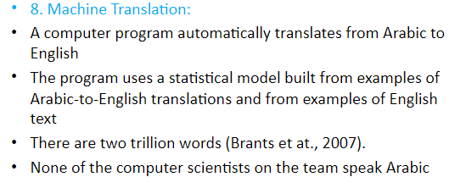
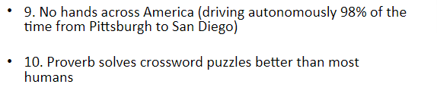
Chinese scientists develop robot fish that gobble up micro plastics
https://www.euronews.com/next/2022/07/14/can-these-robot-fish-developed-by-chinese-researchers-help-us-save-the-ocean

Slide 16
Major Branches of AI
  Perceptive system
    A system that approximates the way a human sees, hears, and feels objects
  Vision system
    Capture, store, and manipulate visual images and pictures
  Robotics
    Mechanical and computer devices that perform tedious tasks with high precision
  Expert system
    Stores knowledge and makes inferences

Slide 17
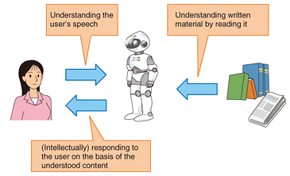
Major Branches of AI
  Learning system
    Computer changes how it functions or reacts to situations based on feedback
  Natural language processing
    Computers understand and react to statements and commands made in a “natural” language, such as English
  Neural network
    Computer system that can act like or simulate the functioning of the human brain

Slide 18
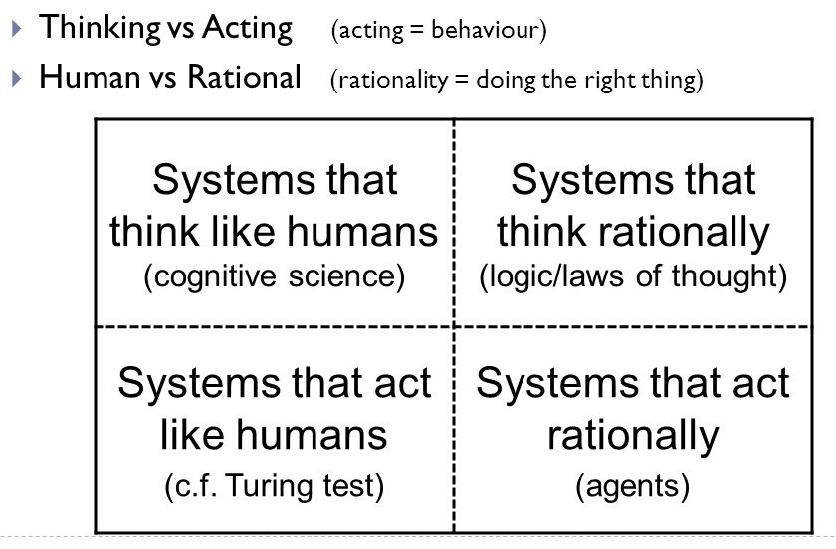
Views of AI
Views of AI fall into four categories:

Slide 19
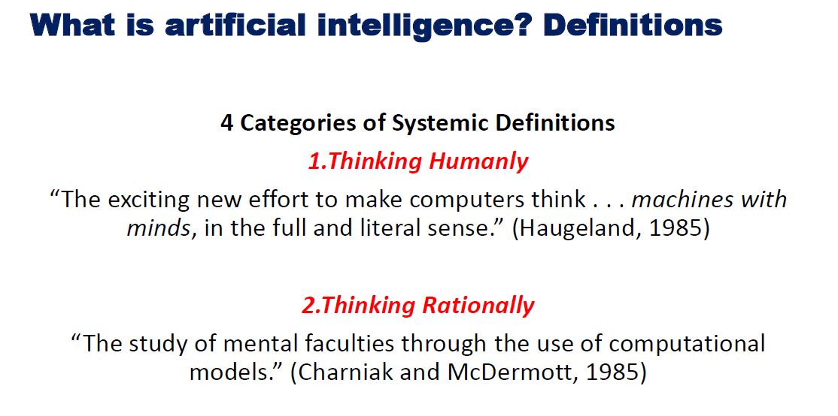

Slide 20
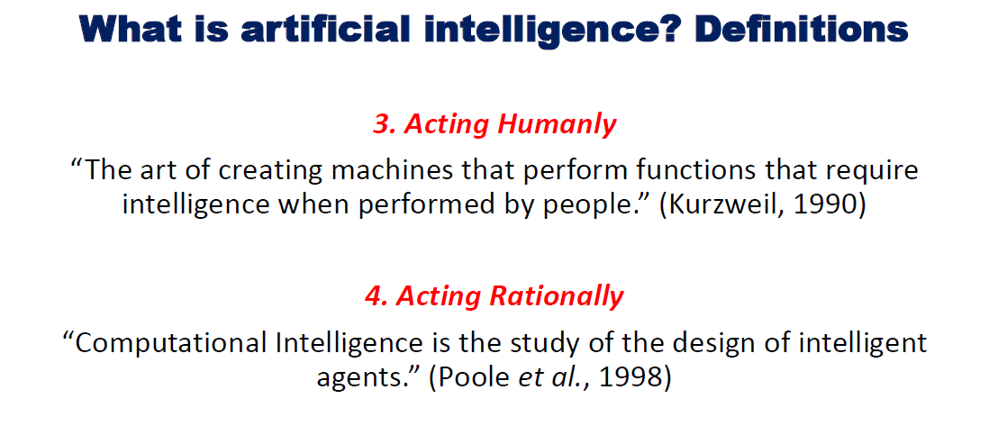

Slide 21
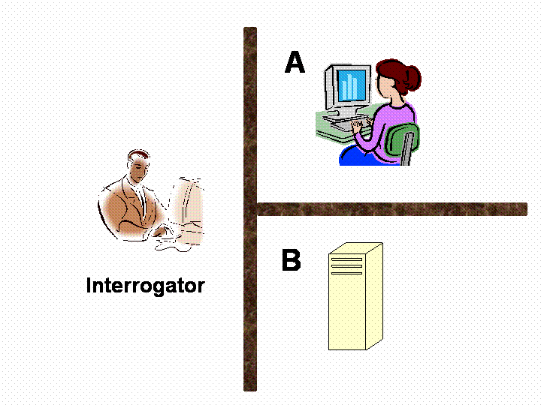
1. Acting humanly: The Turing test
Test proposed by Alan Turing in 1950
Conversations between Interrogator, Computer and Humans
The computer need to possess the following capabilities :
Natural Language processing
Knowledge Representation
Automated Reasoning
Machine Learning
Computer vision
Robotics

Slide 22
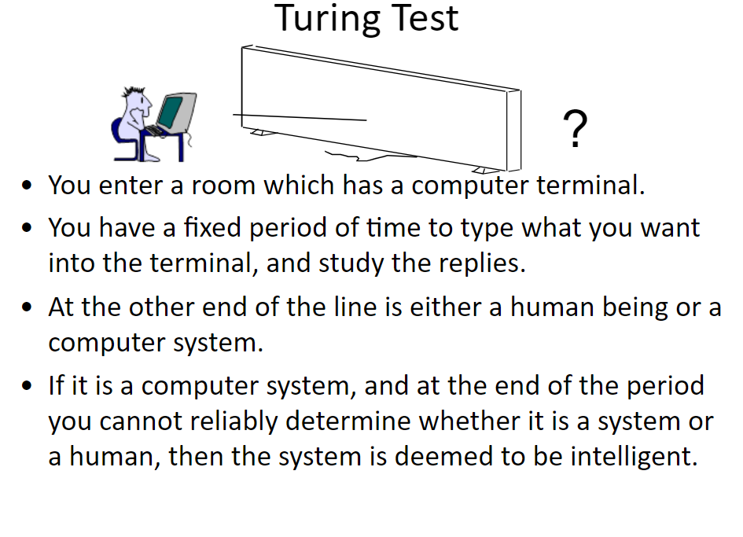

Slide 23
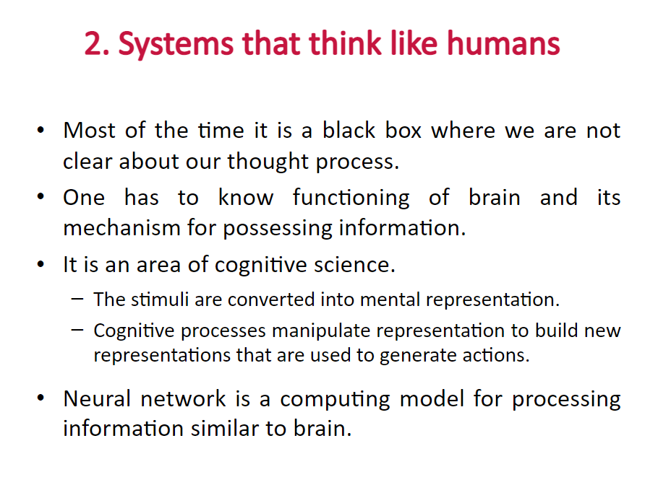

Slide 24
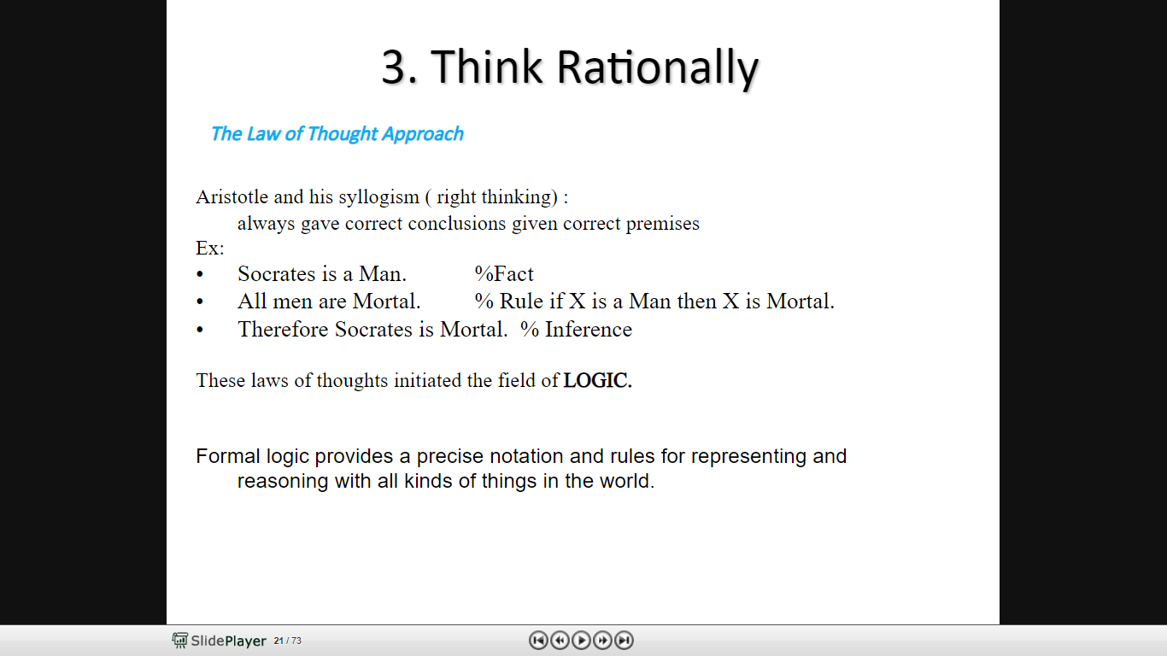

Slide 25
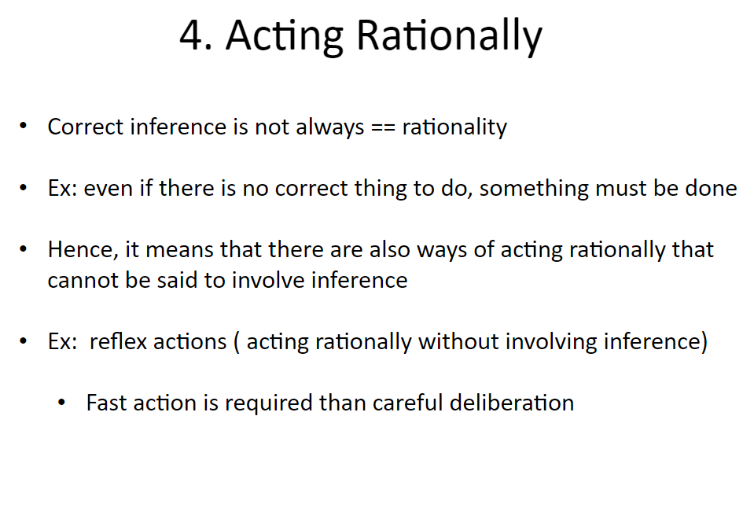

Slide 26
AI Advantages
Reduction in Human Error
Takes risks instead of Humans
Available 24x7
Helping in Repetitive Jobs
Digital Assistance
Faster Decisions
More powerful and more useful computers
New and improved interfaces
Solving new problems
Better handling of information
Relieves information overload
Conversion of information into knowledge

Slide 27
Disadvantages
High Cost of Implementation
Can’t Replace Humans
Doesn’t Improve With Experience
Lacks Creativity
Risk of Unemployment
Difficulty with software development - slow and expensive
Few experienced programmers
Few practical products have reached the market as yet.
Chess-playing robot in Russia turns violent mid-match and breaks a 7-year-old boy’s finger.
https://indianexpress.com/article/sports/chess/rogue-robot-breaks-childs-finger-during-chess-match-8049075/

Slide 28
Representations/Languages Used
First order logic
Higher order logic
Logic programs
Frames
Production Rules
Semantic Networks
Fuzzy logic
Bayes nets
Hidden Markov models
Neural networks
Strips
Some standard AI programming languages have been developed in order to build intelligent programs efficiently and robustly. These include:
  Prolog
  Lisp (LISt Processing)
  ML (Metalanguage)
Other languages are also used extensively to build AI programs, including:
  Perl
  C++
  Java
  C

Slide 29
Categorization of AI
    Narrow Intelligence
    General Intelligence
    Super Intelligence

Slide 30
Categorization of AI…contd
Narrow (or) Weak artificial intelligence : It is an artificial intelligence that is focused on one narrow task.
Artificial general intelligence is also referred to as "strong AI" or "full AI". It as the ability of a machine to perform "general intelligent action".
A superintelligence is a hypothetical agent that possesses intelligence far surpassing that of the brightest and most gifted human minds.
"Superintelligence" may also refer to a property of problem-solving systems (e.g., superintelligent language translators or engineering assistants) whether or not these high-level intellectual competencies are embodied in agents that act in the world.
A superintelligence may or may not be created by an intelligence explosion and associated with a technological singularity.

Slide 31
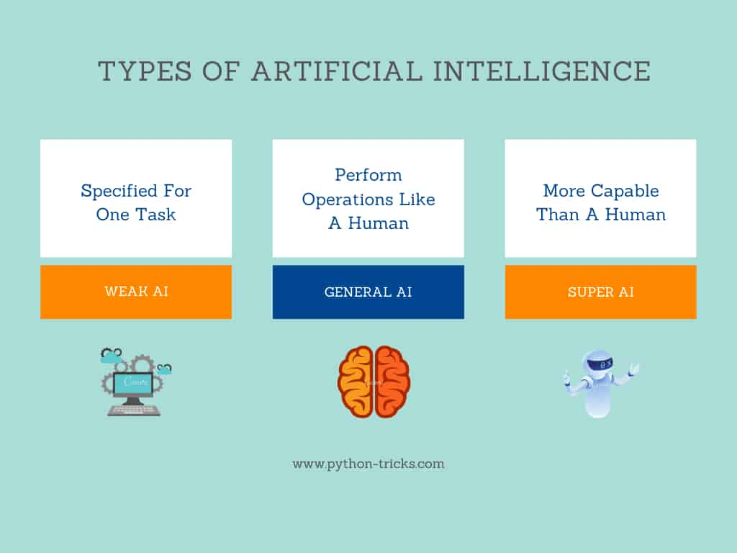

Slide 32
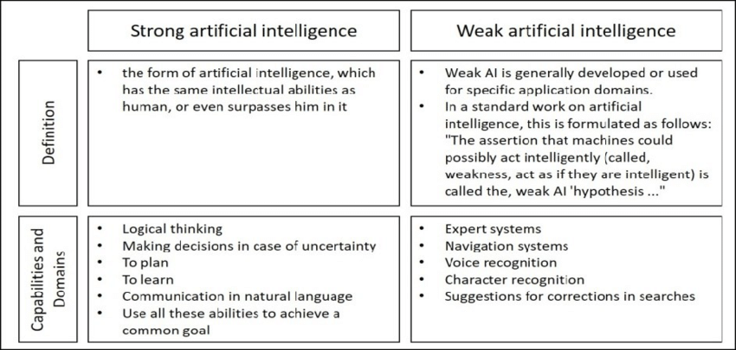

Slide 33
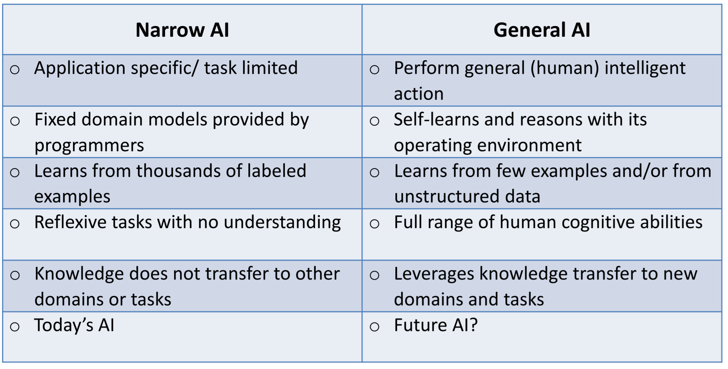

Slide 34
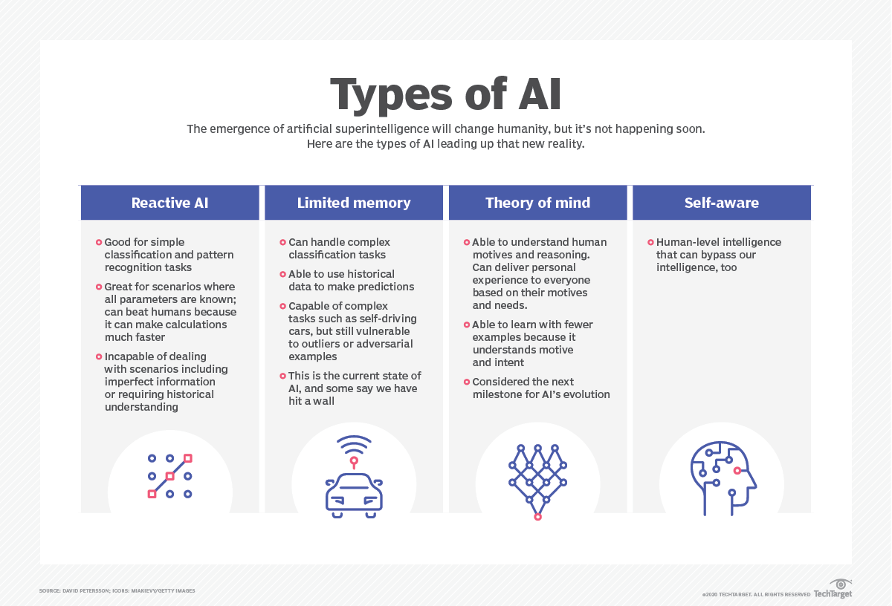

Slide 35
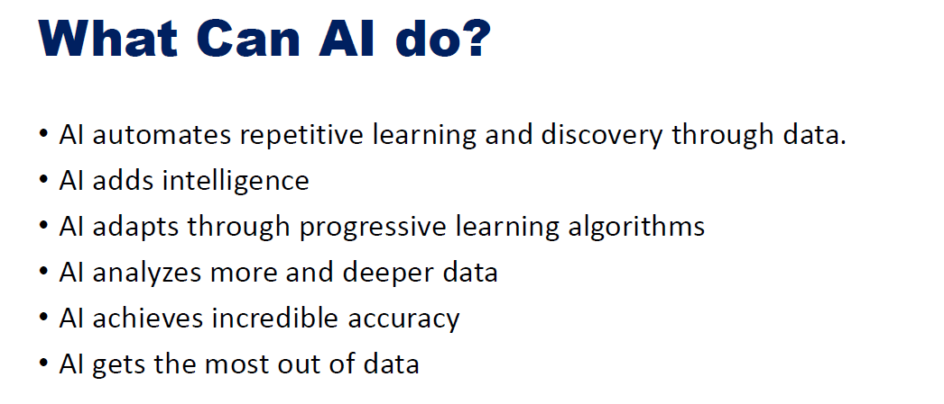

Slide 36
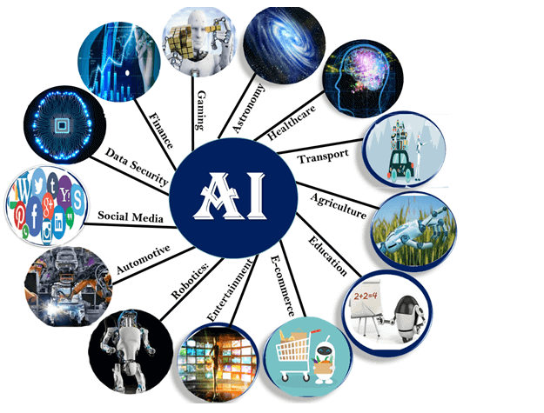
Applications

Slide 37
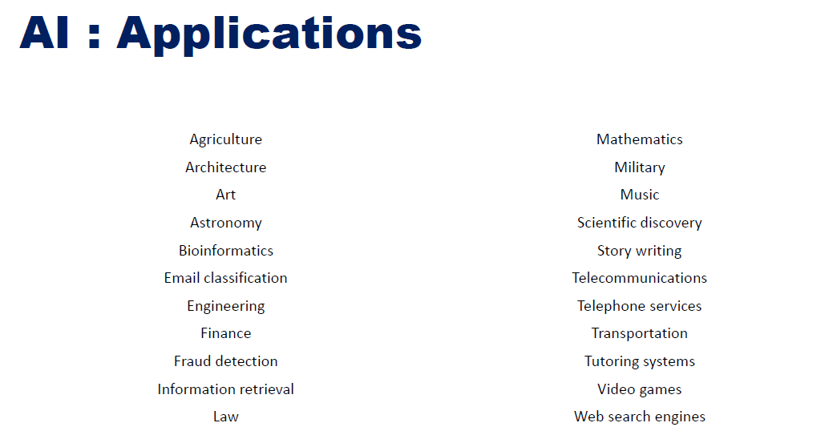

Slide 38
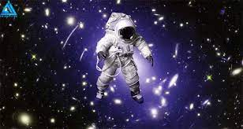
AI applications
AI in Astronomy
Artificial Intelligence can be very useful to solve complex universe problems. AI technology can be helpful for understanding the universe such as how it works, origin, etc.
To take on the challenges, astronomers are turning to machine learning and artificial intelligence (AI) to build new tools to rapidly search for the next big breakthroughs.

Slide 39
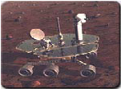
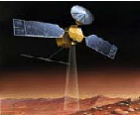
AI Applications
Autonomous Planning & Scheduling:
  Autonomous rovers.

Slide 40
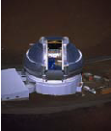

AI Applications
Autonomous Planning & Scheduling:
  Telescope scheduling

Slide 41



AI Applications
Autonomous Planning & Scheduling:
  Analysis of data:

Slide 42
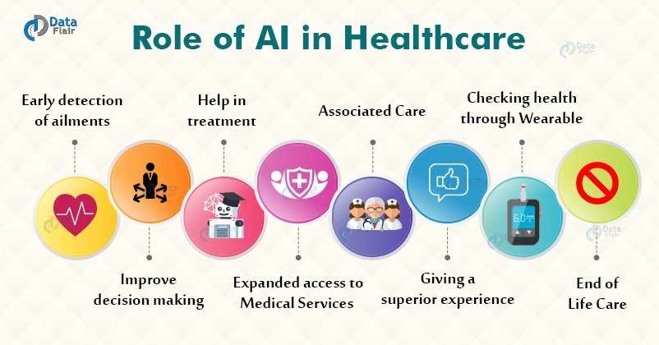
AI applications
AI in Healthcare : In the last, five to ten years, AI becoming more advantageous for the healthcare industry and going to have a significant impact on this industry.
Healthcare Industries are applying AI to make a better and faster diagnosis than humans. AI can help doctors with diagnoses and can inform when patients are worsening so that medical help can reach to the patient before hospitalization.

Slide 43
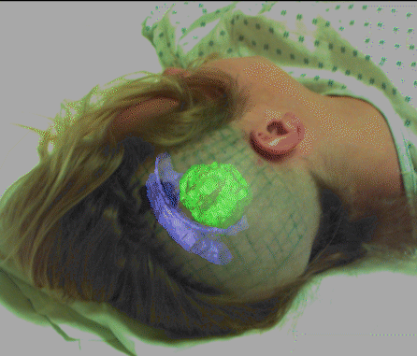

AI Applications
Medicine:
  Image guided surgery

Slide 44


AI Applications
Medicine:
  Image analysis and enhancement

Slide 45
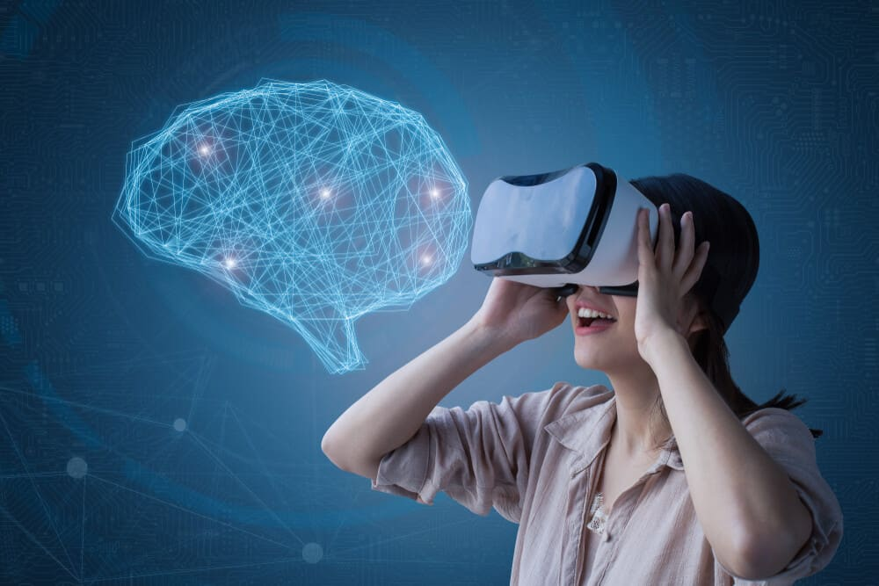
AI applications cont…
AI in Gaming
AI can be used for gaming purpose. The AI machines can play strategic games like chess, where the machine needs to think of a large number of possible places.

Slide 46

AI Applications
Games:

Slide 47
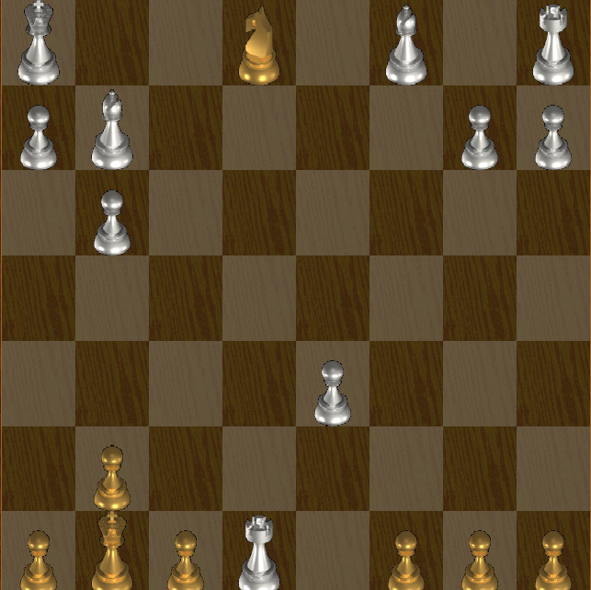
AI Applications
Games:

Slide 48
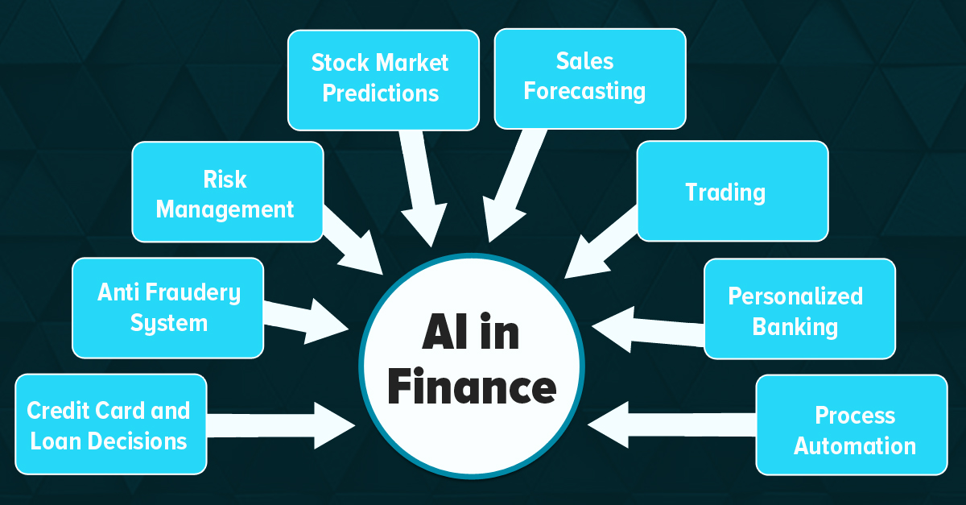
AI in Finance
AI and finance industries are the best matches for each other. The finance industry is implementing automation, Chatbot, adaptive intelligence, algorithm trading, and machine learning into financial processes.

Slide 49

AI applications cont…
AI in Data Security
The security of data is crucial for every company and cyber-attacks are growing very rapidly in the digital world. AI can be used to make your data more safe and secure. Some examples such as AEG bot, AI2 Platform are used to determine software bug and cyber-attacks in a better way.

Slide 50

AI in Social Media
Social Media sites such as Facebook, Twitter, and Snapchat contain billions of user profiles, which need to be stored and managed in a very efficient way. AI can organize and manage massive amounts of data. AI can analyze lots of data to identify the latest trends, hashtag, and requirement of different users.

Slide 51
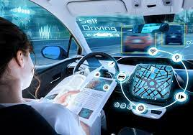
AI in Travel & Transport
AI is becoming highly demanding for travel industries. AI is capable of doing various travel related works such as from making travel arrangement to suggesting the hotels, flights, and best routes to the customers. Travel industries are using AI-powered chatbots which can make human-like interaction with customers for better and fast response.

Slide 52

AI Applications
Transportation:
  Autonomous vehicle control:

Slide 53

AI Applications
Transportation:
  Pedestrian detection:

Slide 54
AI applications cont…
AI in Automotive Industry
Some Automotive industries are using AI to provide virtual assistant to their user for better performance. Such as Tesla has introduced TeslaBot, an intelligent virtual assistant.
Various Industries are currently working for developing self-driven cars which can make your journey more safe and secure.
AI in Robotics:
Artificial Intelligence has a remarkable role in Robotics. Usually, general robots are programmed such that they can perform some repetitive task, but with the help of AI, we can create intelligent robots which can perform tasks with their own experiences without pre-programmed.
Humanoid Robots are best examples for AI in robotics, recently the intelligent Humanoid robot named as Erica and Sophia has been developed which can talk and behave like humans.

Slide 55

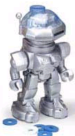
AI Applications
Robotic toys:

Slide 56
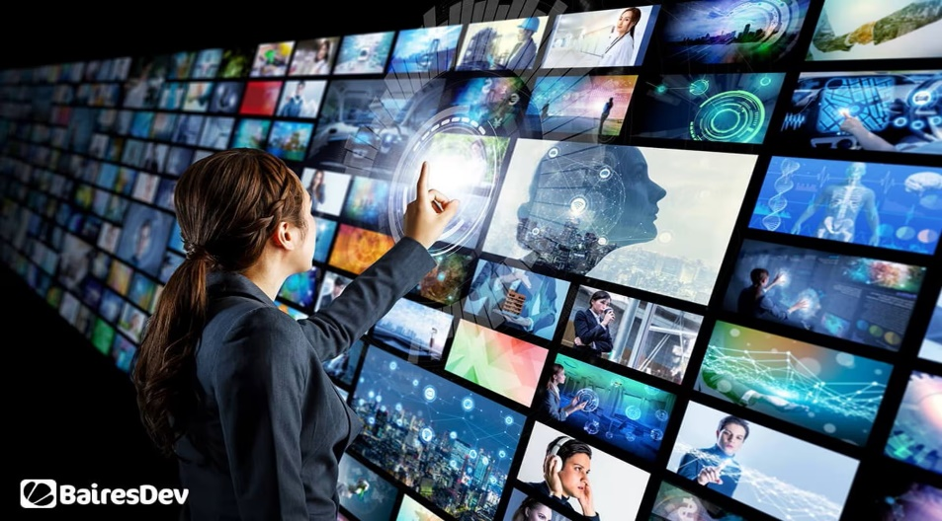
AI applications cont…
AI in Entertainment
We are currently using some AI based applications in our daily life with some entertainment services such as Netflix or Amazon. With the help of ML/AI algorithms, these services show the recommendations for programs or shows.

Slide 57
AI applications cont…
AI in Agriculture
Agriculture is an area which requires various resources, labor, money, and time for best result. Now a day's agriculture is becoming digital, and AI is emerging in this field. Agriculture is applying AI as agriculture robotics, solid and crop monitoring, predictive analysis. AI in agriculture can be very helpful for farmers.
AI in E-commerce
AI is providing a competitive edge to the e-commerce industry, and it is becoming more demanding in the e-commerce business. AI is helping shoppers to discover associated products with recommended size, color, or even brand.
AI in education
AI can automate grading so that the tutor can have more time to teach. AI Chatbot can communicate with students as a teaching assistant.
AI in the future can be work as a personal virtual tutor for students, which will be accessible easily at any time and any place.

Slide 58
AI Applications
Other application areas:
Bioinformatics:
  Gene expression data analysis
  Prediction of protein structure
Text classification, document sorting:
  Web pages, e-mails
  Articles in the news
Video, image classification
Music composition, picture drawing
Natural Language Processing

Slide 59
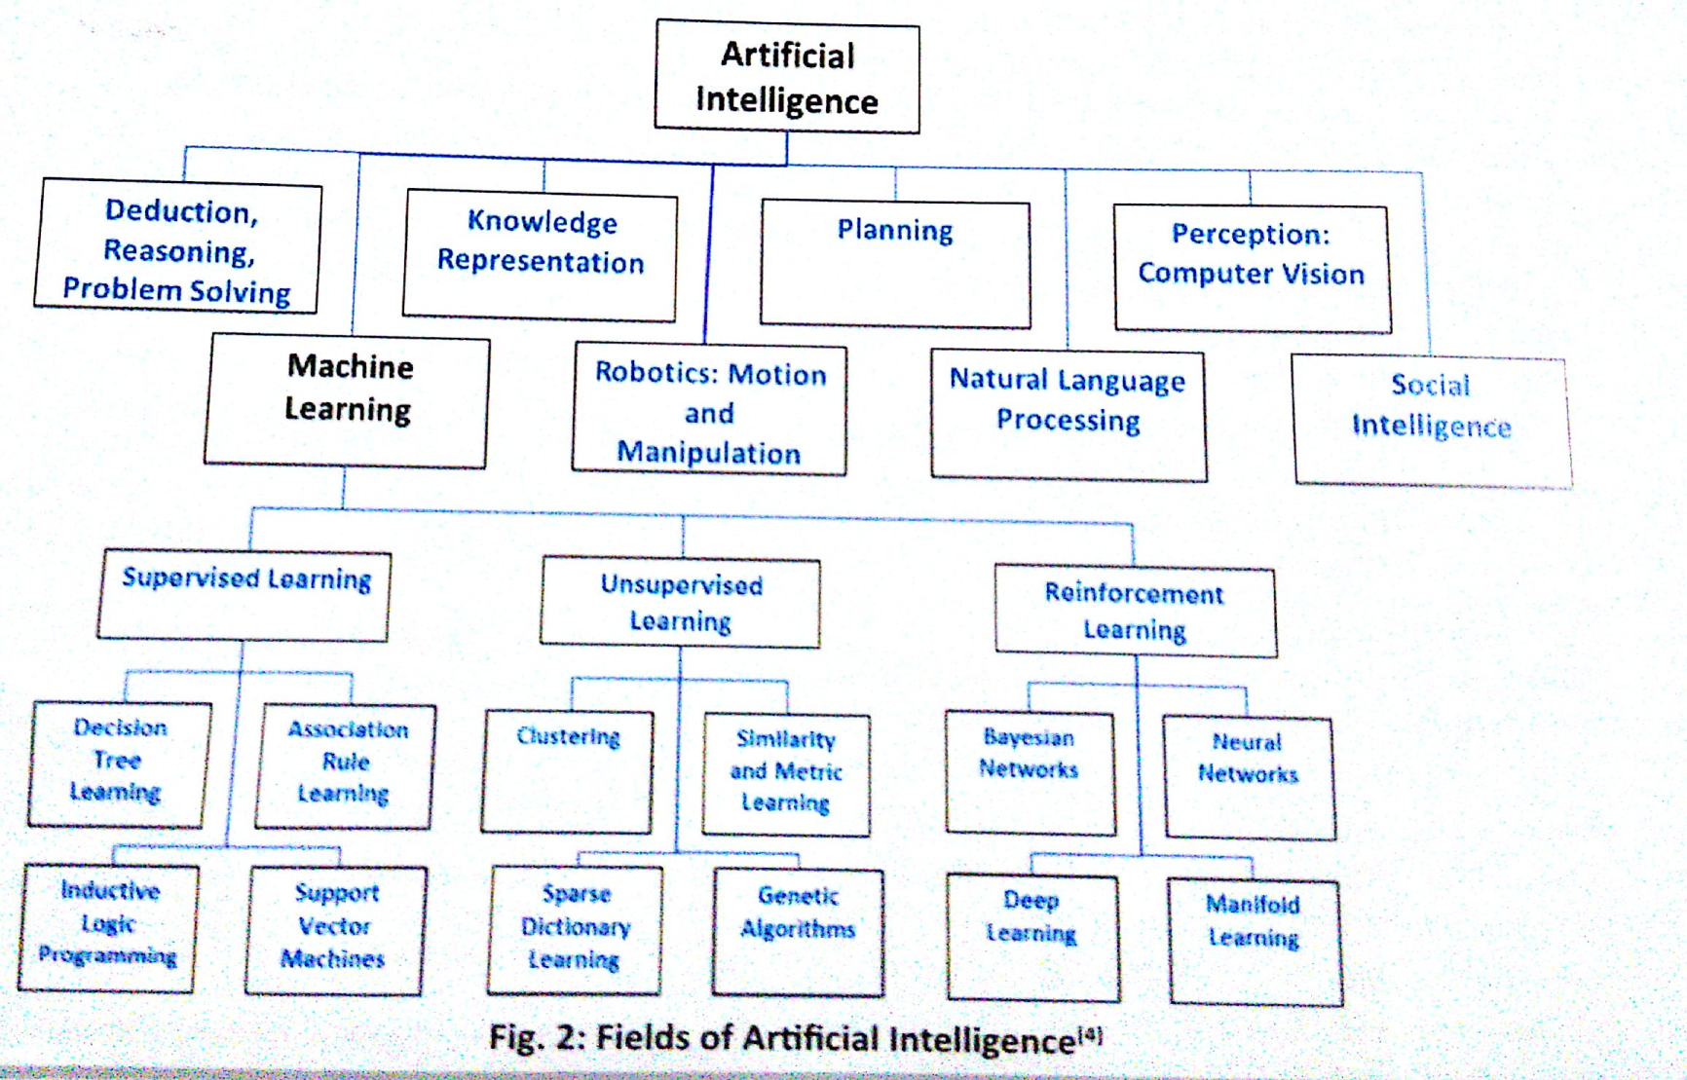
FIELDS OF ARTIFICIAL INTELLIGENCE(AI)
Notes:
12

Slide 60
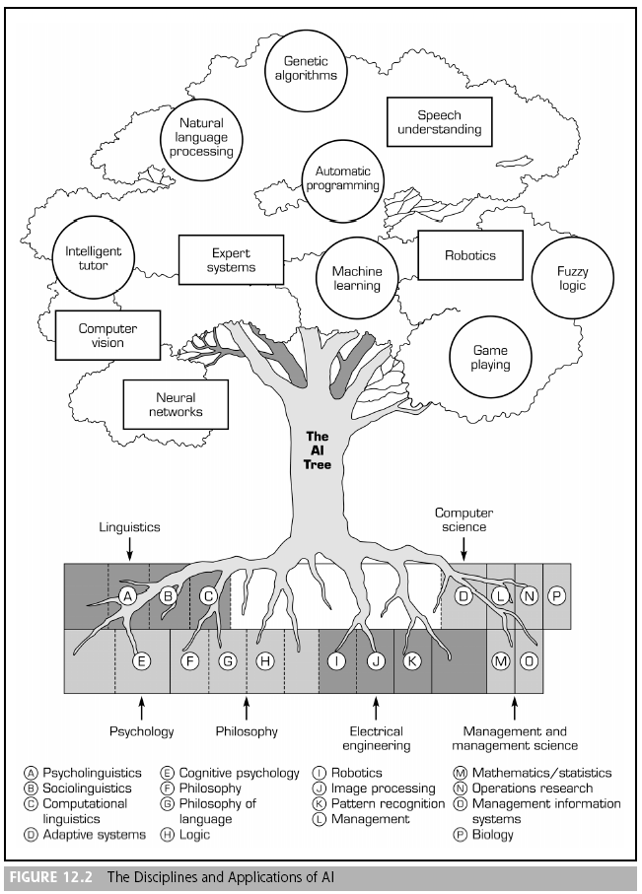

Slide 61
Areas of AI and Some Dependencies
Knowledge Representation
Search
Logic
Machine Learning
Planning
Expert Systems
NLP
Vision
Robotics

Slide 62
Generic Techniques Developed
Forward/backward chaining (reasoning)
Resolution theorem proving (reasoning)
Proof planning (reasoning)
Constraint satisfaction (reasoning)
Davis-Putnam method (reasoning)
Minimax search (games)
Alpha-Beta pruning (games)
Case-based reasoning (expert systems)
Knowledge elicitation (expert systems)
Neural networks (learning)
Bayesian methods (learning)
Explanation based (learning)
Inductive logic programming (learning)
Reinforcement (learning)
Genetic algorithms (learning)
Genetic programming (learning)
Strips (planning)
N-grams (NLP)
Parsing (NLP)
Behaviour based (robotics)
Cell decomposition (robotics)

